Slide 1

Team Harlequin
Kristi Belcher, Jared Coplin, Eric Rhyne, Esther Conrad, Richard P-Ferry, Eric Johnson
Sentiment Analysis tool for City of Austin, TX

Slide 2
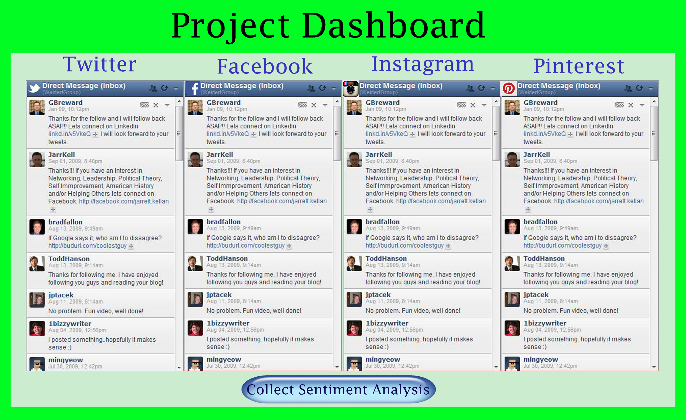
Demo – Start up page

Slide 3
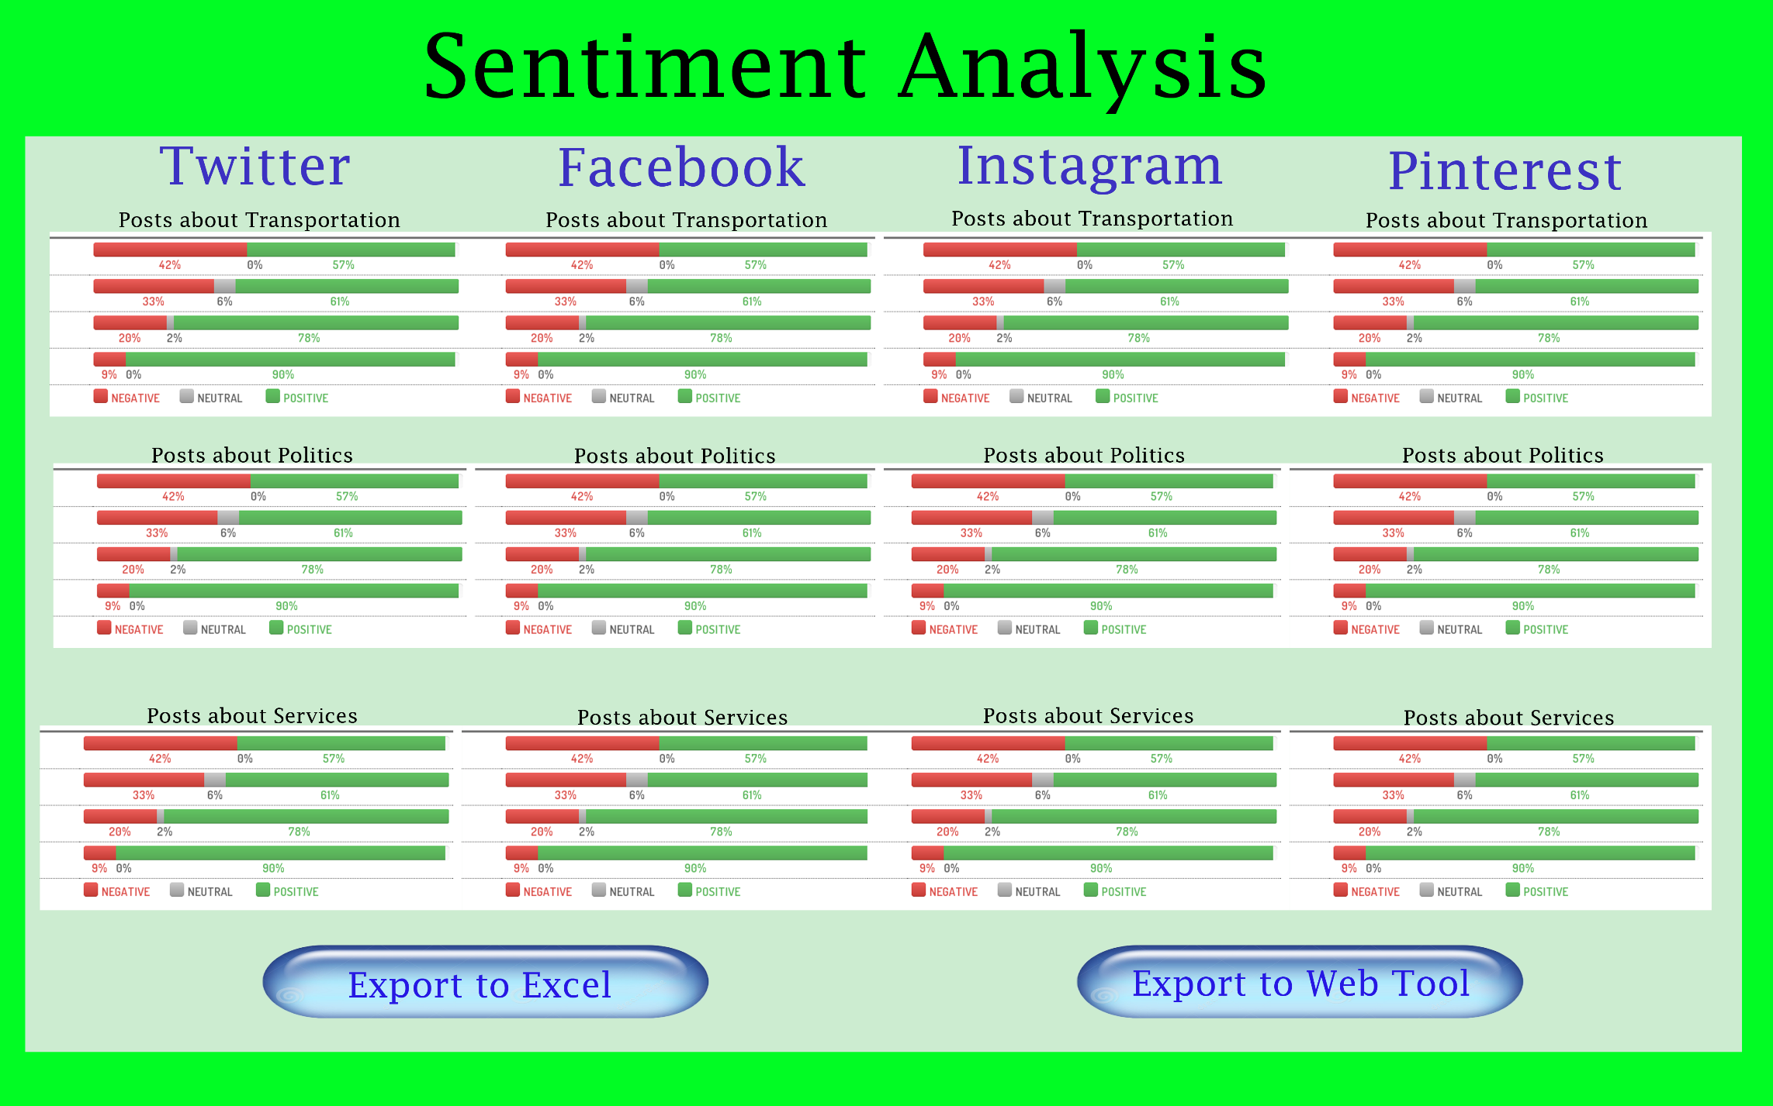
Demo – Sentiment Analysis Tool

Slide 4
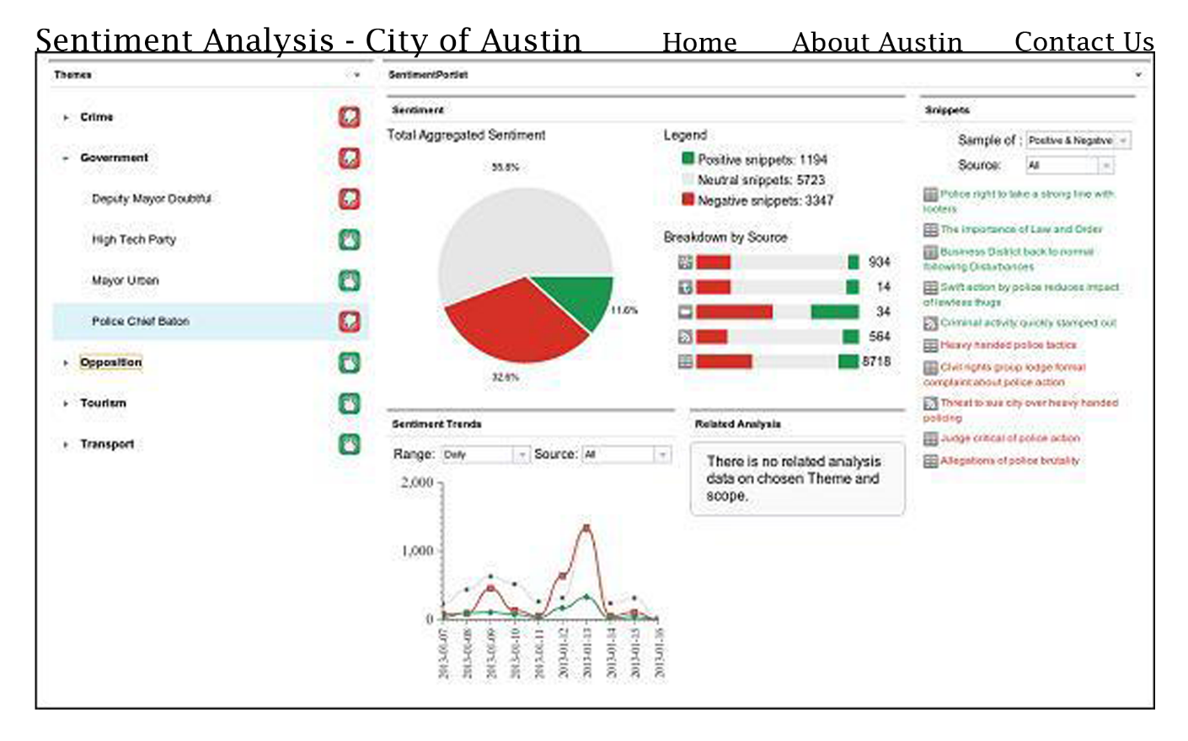
Demo – Web Tool

Slide 5
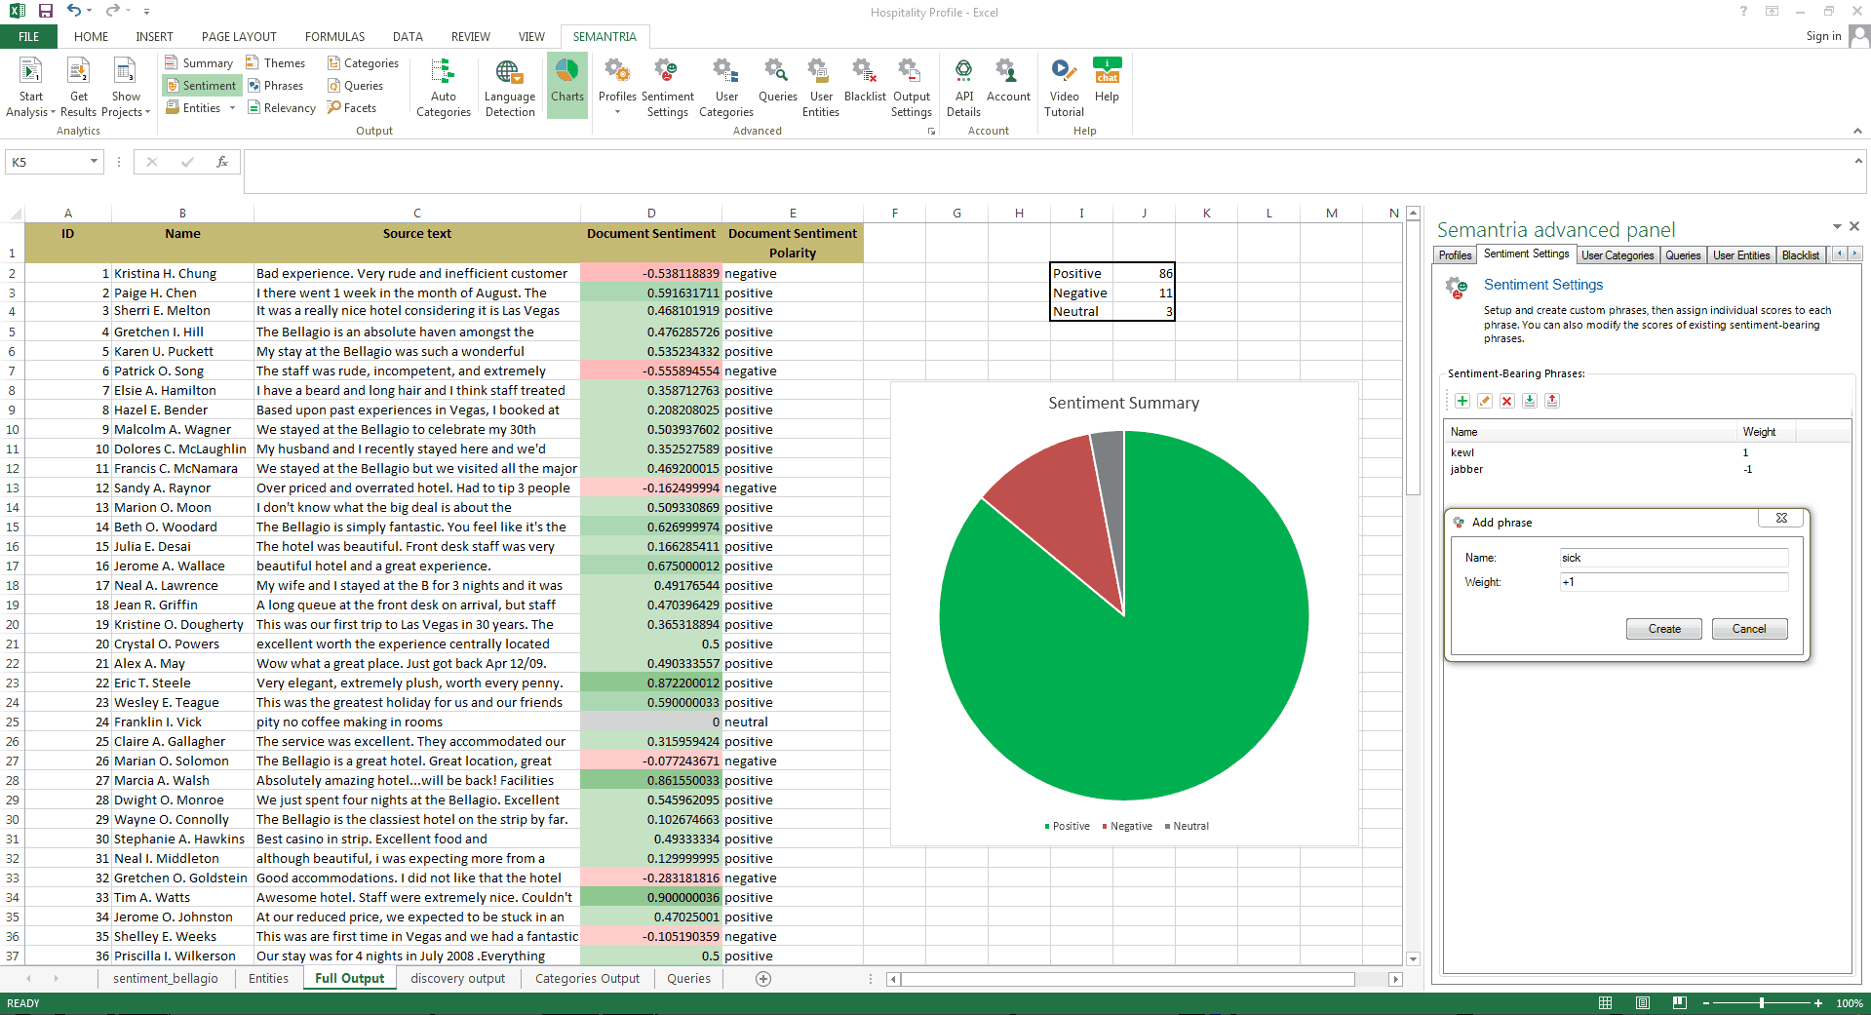
Demo – Excel Tool

Slide 6
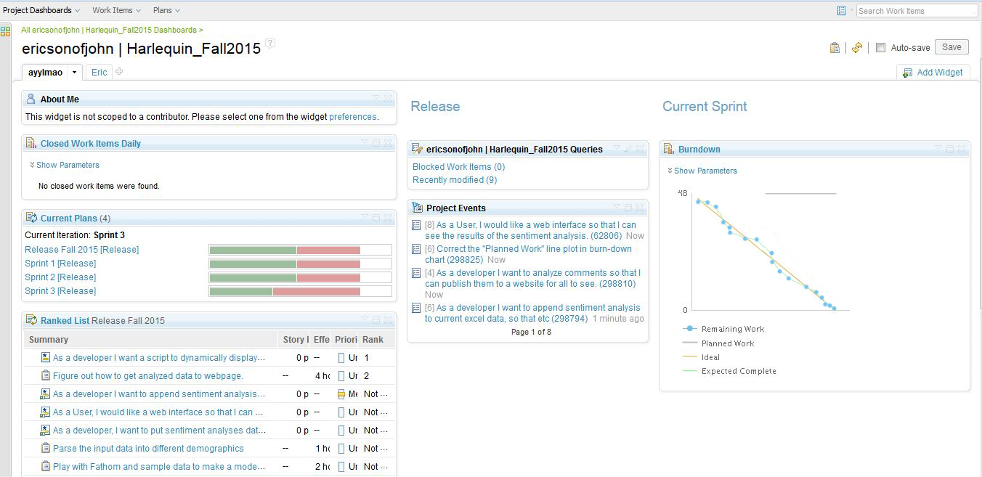
Burndown Chart

Slide 7
UML Applications
Use Case Diagram
Shows relationship between actors and functionalities, and the relationship between the two
Class Diagram
Shows more in-depth look at the application in terms of classes used in implementation
Defines levels of implementation

Slide 8
Example: Class Diagram of Our Project
Positive Sentiment
Sub - Classes
Resident Sentiment Report
Positive Sentiment
Date: string
Location: string
Date: String
Post()
Analyze()
Base Classes
n
Neutral Sentiment
1
Date: String
City of Austin Employees
Analyze()
Date: string
Location: string
Negative Sentiment
Date: String
Collect()
Analyze()

Slide 9
Next Steps:
Continue learning about development tools
Django
Python
Etc.
Build and Release
Project details to Sarah and Ashley
UX and UI improvement
User testing

